Slide 1

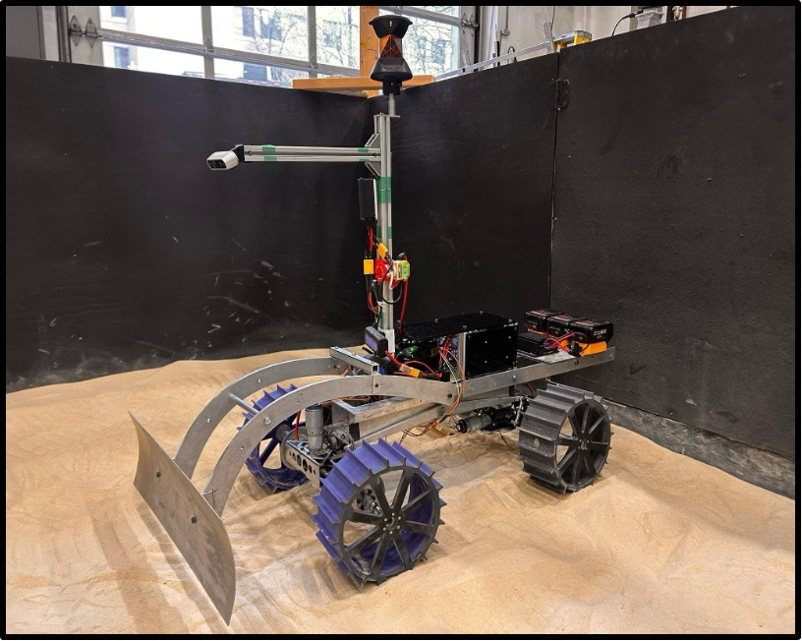

Lunar ROADSTER
(Robotic Operator for Autonomous Development of Surface Trails and Exploration Routes)
“Starting with a foothold on the Moon, we pave the way to the cosmos”

Slide 2
NASA-STD-8739.10
Electrical, Electronic, and Electromechanical (EEE) Parts Assurance Standard

Slide 3

NASA-STD-8739.10: What is it about?
Establish a consistent, Agency-wide set of requirements for managing EEE parts in space flight hardware
Manages the selection, acquisition, traceability, testing, handling, packaging, storage, and application of EEE parts as required by NASA Policy Directive (NPD) 8730.2, NASA Parts Policy
Summary: To control risk and enhance reliability in NASA space flight hardware and critical ground support equipment

Slide 4





NASA-STD-8739.10: Where does it apply?
Target Market: For “scientific and engineering organizations engaged in space and ground testing technology development”
Government labs
Internal NASA use
Academic institutions
Contractors
Private space companies

Slide 5
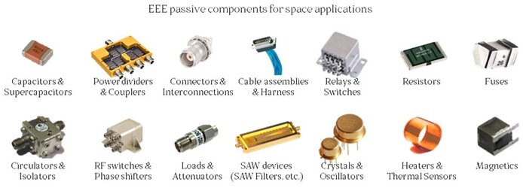
NASA-STD-8739.10: Where does it apply?
Products: Electrical, Electronic, and Electromechanical parts used for space applications
Different EEE Parts

Slide 6
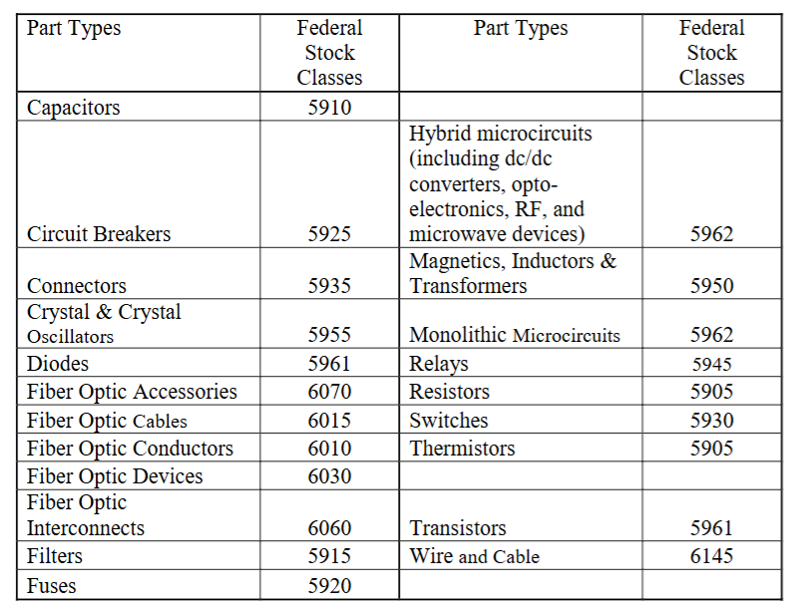
NASA-STD-8739.10: Main prescriptions
Guideline 1: Parts Selection and Grading
Parts must be selected to meet performance and reliability requirements in the worst-case predicted mission environment (e.g., thermal, vibration, radiation)

Slide 7
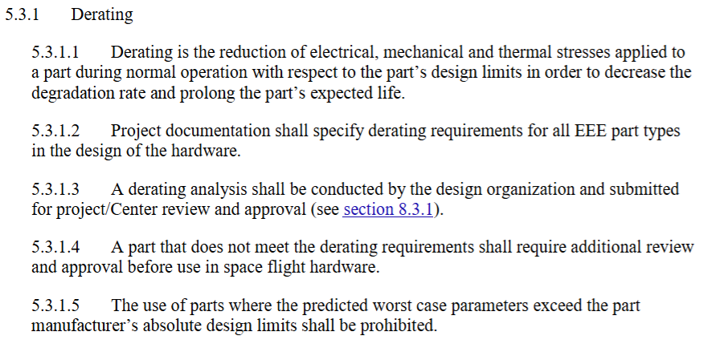
NASA-STD-8739.10: Main prescriptions
Guideline 2: Derating Analysis
Programs shall document the derating criteria for all EEE parts
To operate parts below their manufacturer-specified maximum stress levels (voltage, current, power) to increase reliability and mission life

Slide 8
NASA-STD-8739.10: Main prescriptions
Guideline 3:
Counterfeit Part Avoidance
Projects shall have a plan to prevent, detect, and mitigate the use of counterfeit EEE parts, typically by procuring only from trusted sources
Parts Lists (Traceability)
Projects shall generate and maintain three lists: As Designed Parts List (ADPL), Approved Parts List (APL), and As Built Parts List (ABPL)
Documentation: EEE Parts Management & Control Plan (EPMCP)
Every project shall develop and implement an integrated EPMCP outlining the program's approach to meeting the standards’ requirements
Non-Standard Parts (NSP) Justification
If a part is used that does not meet the prescribed reliability grade, it must be documented as an NSP and receive formal approval (waiver) from the relevant Parts Control Board (PCB)

Slide 9
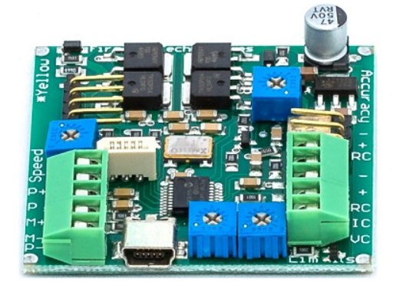
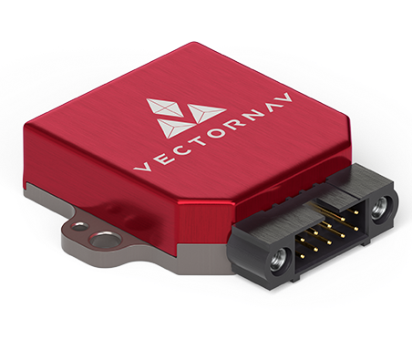
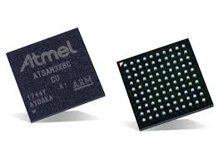
NASA-STD-8739.10: Application to project
We are using multiple EEE parts across our system!
We made sure our EEE parts are properly rated, reliable, and tested
For example, the IMU we used is specifically designed to operate in a wider range of temperatures seen on the moon

Slide 10



NASA-STD-8739.10:: Application to project
Counterfeit Avoidance: We strictly controlled our supply chain, ensuring all computers, microprocessors, and motor drivers were procured from reputable distributors to guarantee quality and avoid system failure

Slide 11
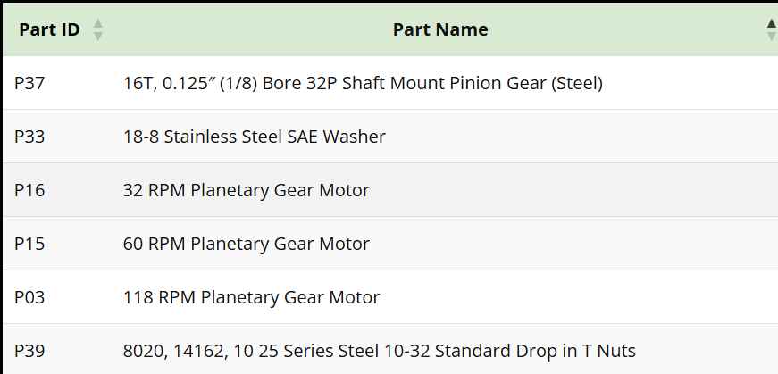
NASA-STD-8739.10: Application to project
Derating: We applied this by ensuring our motor controllers and power electronics are oversized for the maximum continuous loads expected, extending their operational life on the lunar surface
Documentation: We applied the principle of the As Built Parts List (ABPL) by meticulously recording the manufacturer, part number, and purchase date for every electronic component used in the final rover build for future reference and failure analysis

Slide 12
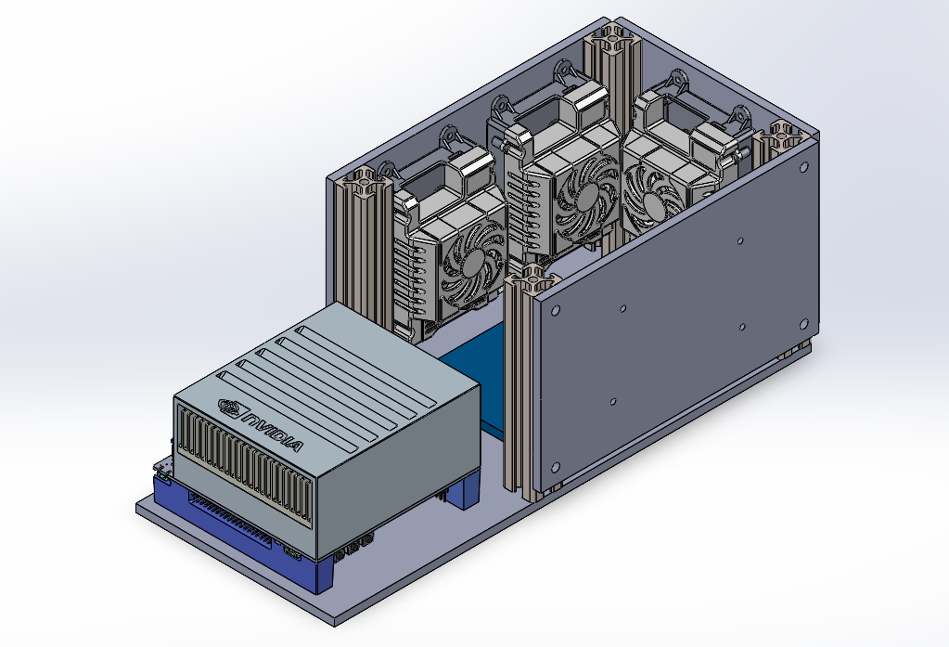
NASA-STD-8739.10: Application to project
Environment Control: We ensured critical parts (motor drivers, GPU, etc.) are temperature controlled by providing adequate cooling

Slide 13
NASA/TP—2006–214605
Lunar Regolith Simulant Materials:
Recommendations for Standardization,
Production, and Usage

Slide 14
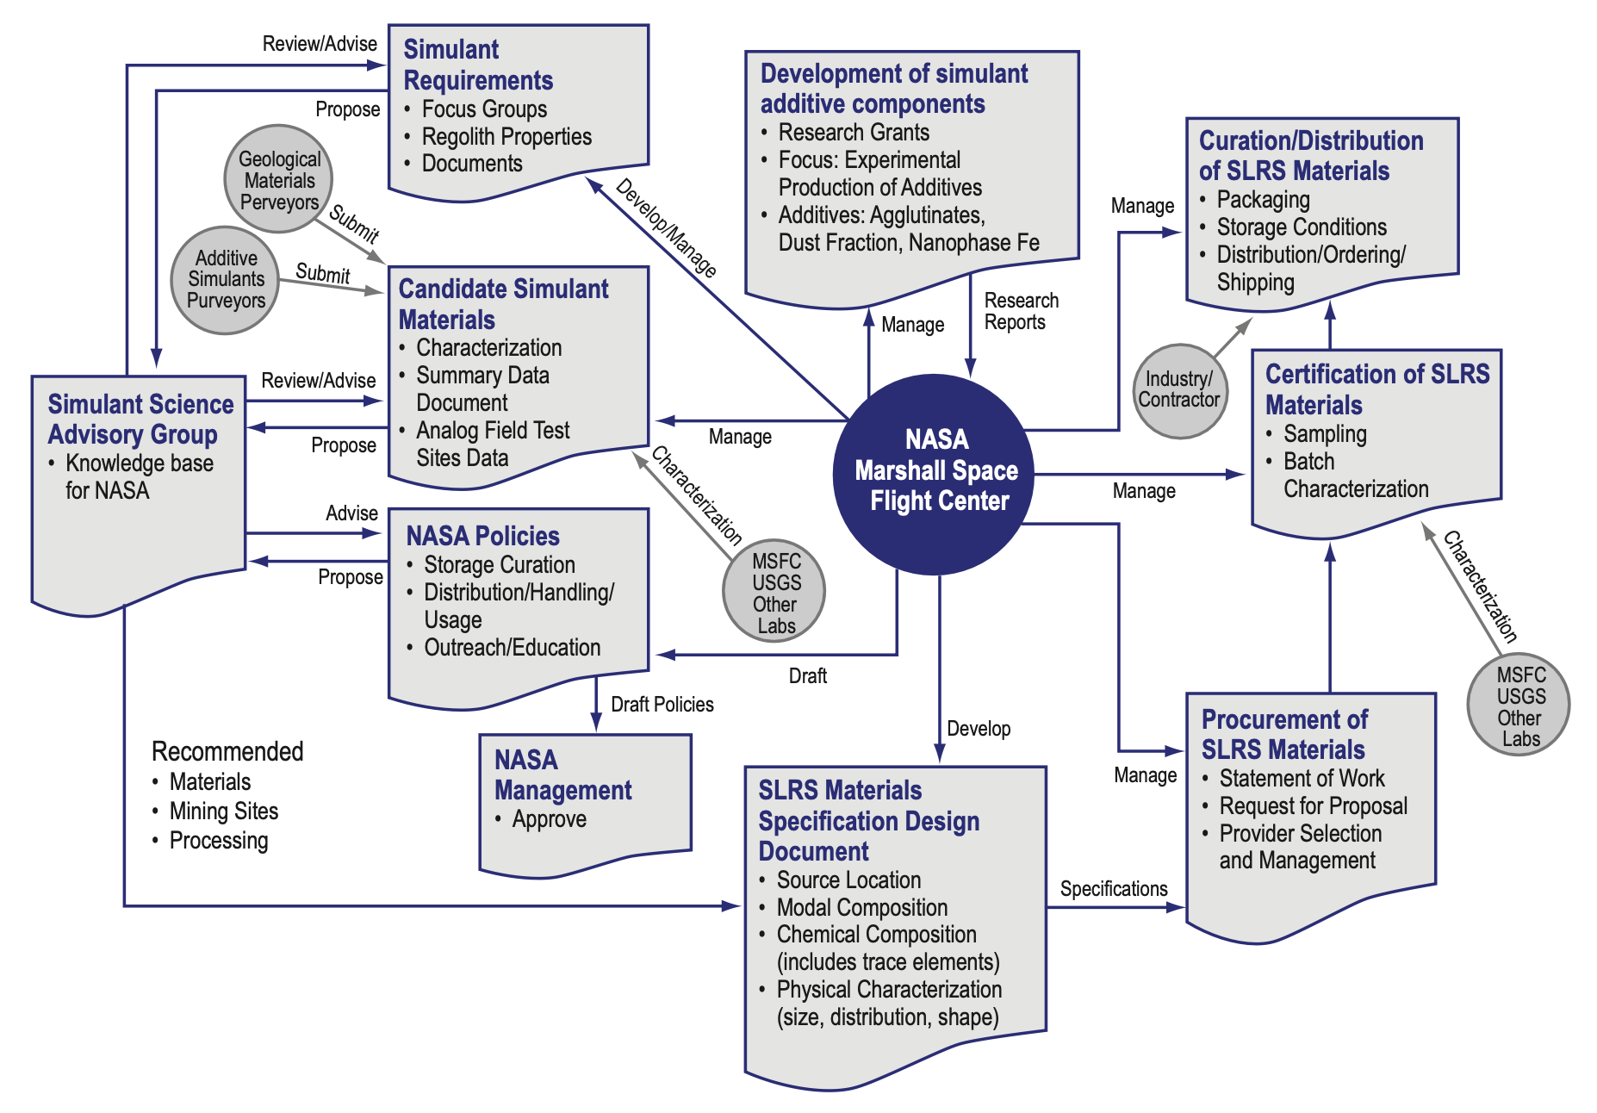
NASA/TP—2006–214605: What is it about?
Standardizing lunar regolith simulants (SLRS) for NASA missions and consistent lunar surface technology testing
Defines regolith families such as mare, highland, and polar soils
Creates process for simulant selection, characterization, and certification
Establishes Simulant Science Advisory Group (SSAG) to guide requirements and policy
Summary: A very complicated and bureaucratic way to source and produce lunar accurate sand

Slide 15


NASA/TP—2006–214605: Where does it apply?
Target Market: For “scientific and engineering organizations engaged in lunar and planetary technology development”
Government labs
Internal NASA use
Academic institutions
DoD space research
Private space companies

Slide 16
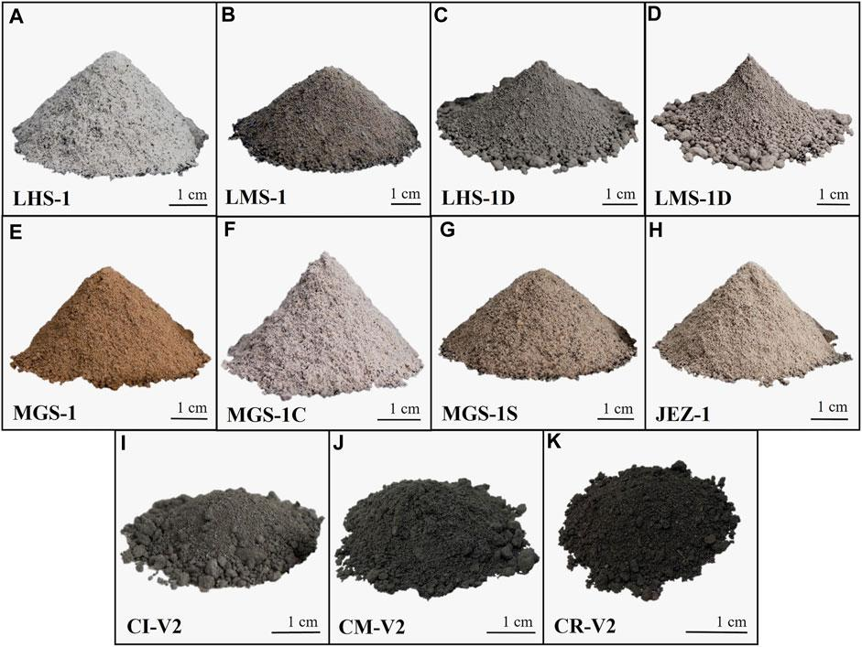
NASA/TP—2006–214605: Where does it apply?
Products: Standard lunar regolith simulant (SLRS) materials
Different lunar regolith simulants

Slide 17
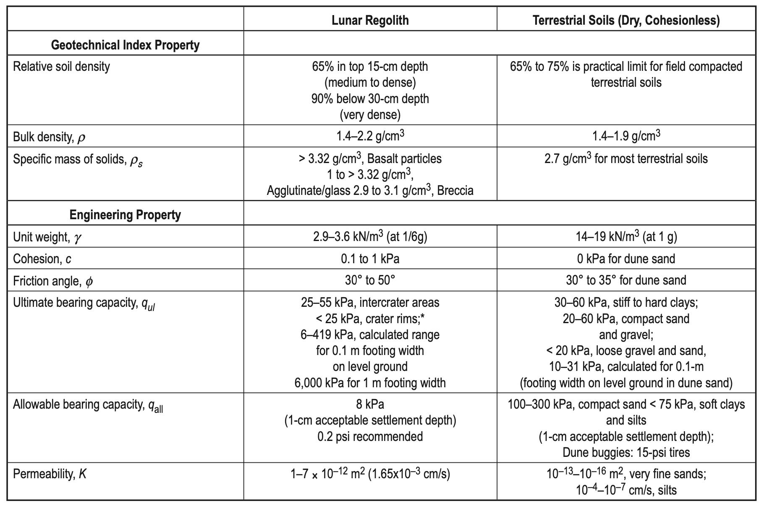
NASA/TP—2006–214605: Main prescriptions
Guideline 1: Regolith geotechnical properties
For “standard” regolith intended to represent average soil encountered on the lunar surface

Slide 18
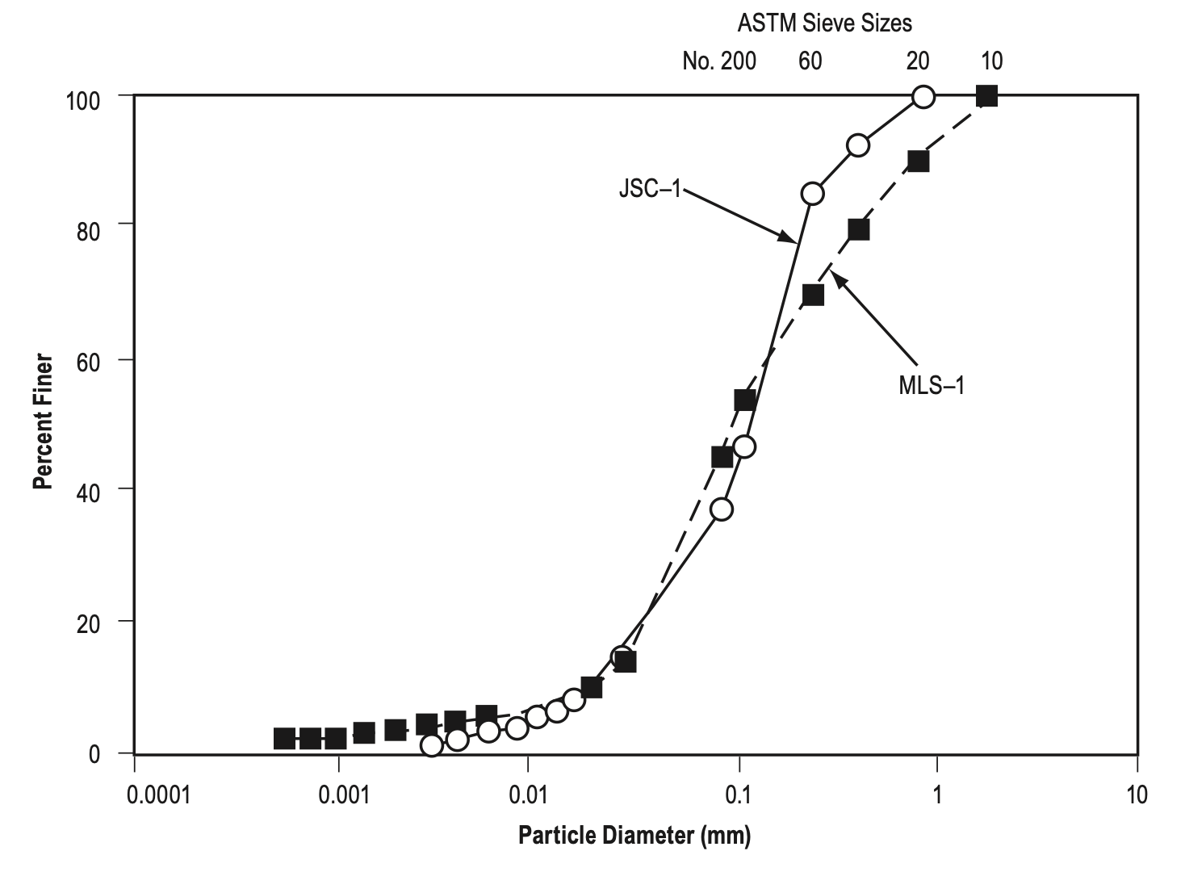
NASA/TP—2006–214605: Main prescriptions
Guideline 2: Particle diameter distribution
Similar to “standard” simulants JSC-1 (Johnson Space Center) and MLS-1 (Minnesota Lunar Regolith)
How to measure similarity left undefined, up to SSAG board to decide

Slide 19
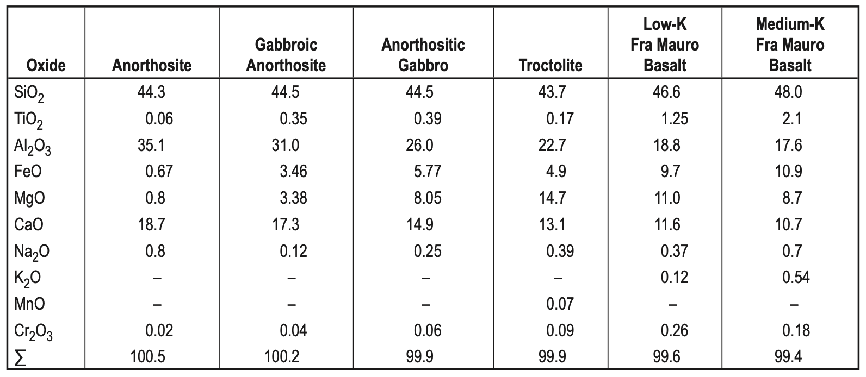
NASA/TP—2006–214605: Main prescriptions
Guideline 3: Particle chemical composition
Oxide weight percentage composition for each representative particle

Slide 20
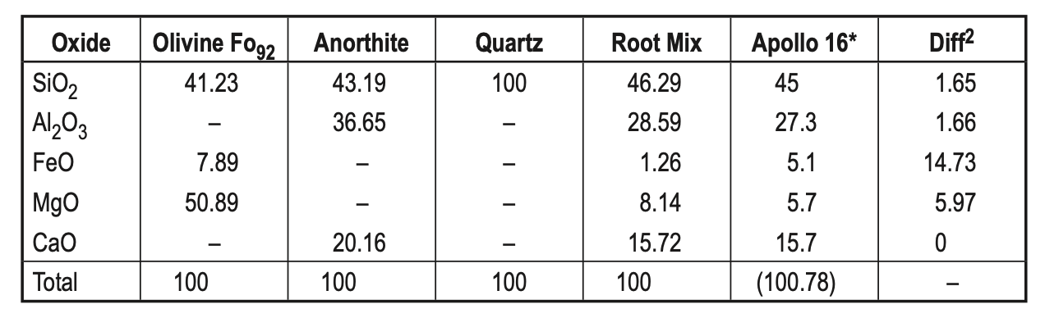
NASA/TP—2006–214605: Main prescriptions
Recommendation 1: Standard Lunar Regolith Simulant Materials
Goal: Establish traceable, standardized lunar soil simulants
Prescription 1: 3 root simulants – baseline materials for each major lunar terrain
Mare Simulant: Low-Titanium Mare Basalt
Highland Simulant: High-Calcium Highland Anorthosite
Polar Simulant: Mixture of Low-Titanium Mare Basalt and High-Calcium Highland Anorthosite
Material mix for mare simulant root mix

Slide 21
NASA/TP—2006–214605: Main prescriptions
Recommendation 1: Standard Lunar Regolith Simulant Materials
Prescription 2: 7 derivative simulants – derivative of root simulant for specific site or system tests
Glass Fraction: Percentage of impact-glass per sample
Agglutinates: Stickiness of the regolith
Nanophase Iron: Percentage of iron per sample
Shocked Grains: Percentage of particles crushed by meteorite impact
Solar-Wind Volatiles: Percentage of particles exposed to solar wind
Dust Fraction: Percentage of particles below 50 µm
Minerals: Adjustments to the chemistry and mineralogy of simulant as required

Slide 22
NASA/TP—2006–214605: Main prescriptions
Recommendation 2: Process for Development, Production, and Certification of Standard Lunar Regolith Simulant Materials
Goal: Create a formal, repeatable pipeline for the production of SLRS to ensure all lunar simulants are high-quality, traceable, and reproducible.
Prescriptions:
Estimate Quantities Needed
Plan production capacity
Define Requirements & Specifications
Set targets for chemistry, mineralogy, grain size, and physical properties
Select Source Materials
Choose terrestrial basalts/anorthosites or synthetic mixes
Initial Batch Screening
Screen candidate materials (composition, mineralogy, particle size) before large-scale production

Slide 23
NASA/TP—2006–214605: Main prescriptions
Prescriptions:
Production & Characterization
Use controlled crushing, blending, and sieving
Packaging
Package under clean, dry conditions
Quality Control
Maintain batch sampling, verification, and traceability records
Curation, Storage & Monitoring
Store under stable environmental conditions
Distribution Management
Central NASA hub to handle logistics, safety, and control
Safety Protocols
Evaluate inhalation and abrasion hazards
Characterization Techniques
Apply standardized methods to characterize the produced material
Simulant Grade Options
Bulk Grade, Technical Grade, and Research Grade

Slide 24
NASA/TP—2006–214605: Main prescriptions
Recommendation 3: Long-Term Simulant Acquisition Strategy
Goal: Establish a sustainable framework for governance, policy, and coordination of all lunar simulant activities
Prescriptions:
Advisory Group on Simulant Materials
Establish the Simulant Science Advisory Group (SSAG)
Expert panelists from planetary science, materials science, geochemistry, and standards
Define technical requirements and review simulant proposals
Recommend certification criteria and quality control methods
Make recommendations on the improvement of existing SLRS materials
Assist in the organization of workshops on lunar simulant materials

Slide 25
NASA/TP—2006–214605: Main prescriptions
Prescriptions:
Policies and Governance for the Development of Standard Simulant Materials
Requirements for Standard Lunar Regolith Simulant Materials
Developmental Research on Selected Simulant Materials
Standard Lunar Regolith Simulant Materials Certification Process
Quality Control of Standard Lunar Regolith Simulant Materials
Storage, Distribution, and Reuse of Standard Lunar Regolith Simulant Materials
Use of Standard Lunar Regolith Simulant Materials by NASA-Sponsored Projects
Use of Standard Lunar Regolith Simulant Materials by Non-NASA-Sponsored Projects
Tracking Standard Lunar Regolith Simulant Material Usage
Procurement of Standard Lunar Regolith Simulant Materials
Caveat: Report intentionally leaves policies and governance structure vague as they relate to future developments and have not been implemented yet

Slide 26
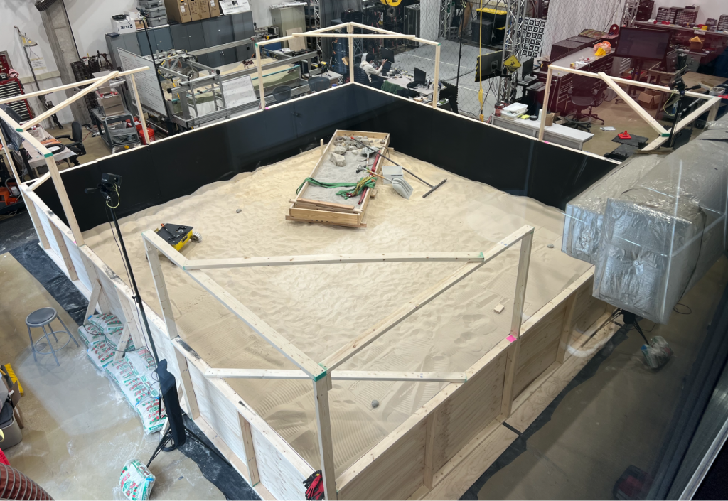
NASA/TP—2006–214605: Application to project
We are using the lunar regolith simulant everyday!
We need to make sure our rover’s capabilities are up to standard in its intended lunar deployment environment
Planetary Robotics Laboratory Moon Yard

Slide 27
NASA/TP—2006–214605: Application to project
The allowable bearing capacity of the regolith guided the development of our performance requirements
M.P.3: The rover shall have a contact pressure of less than 1.5 kPa

Slide 28
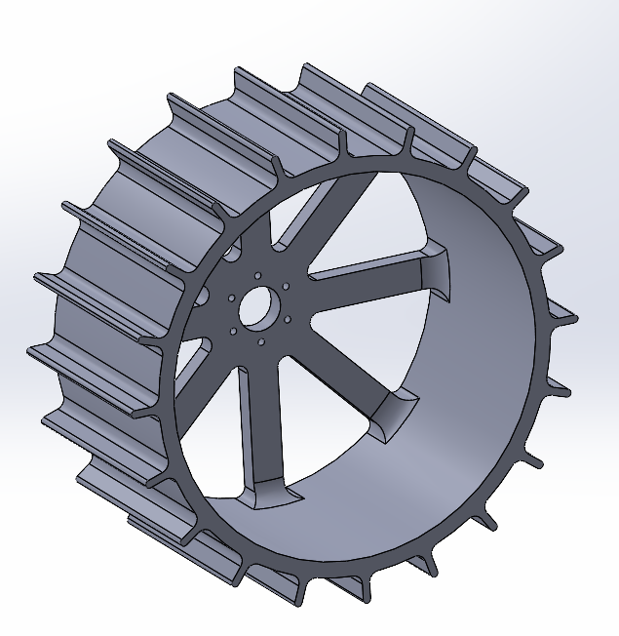
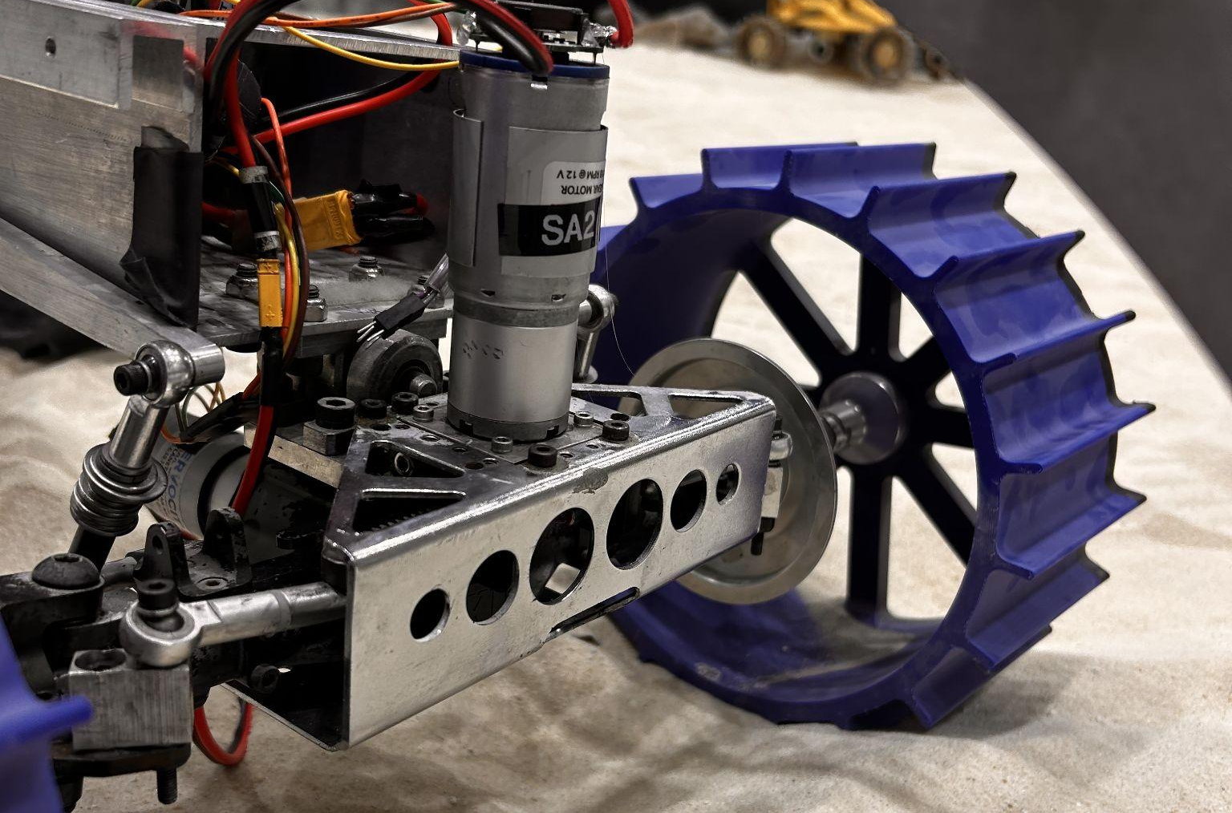
NASA/TP—2006–214605: Application to project
The low agglutinate (stickiness) and friction of the fine powdery regolith led to the development of our customized wheel with high grousers. This is designed for maximizing traction, minimizing slip, and allowing for efficient steering

Slide 29
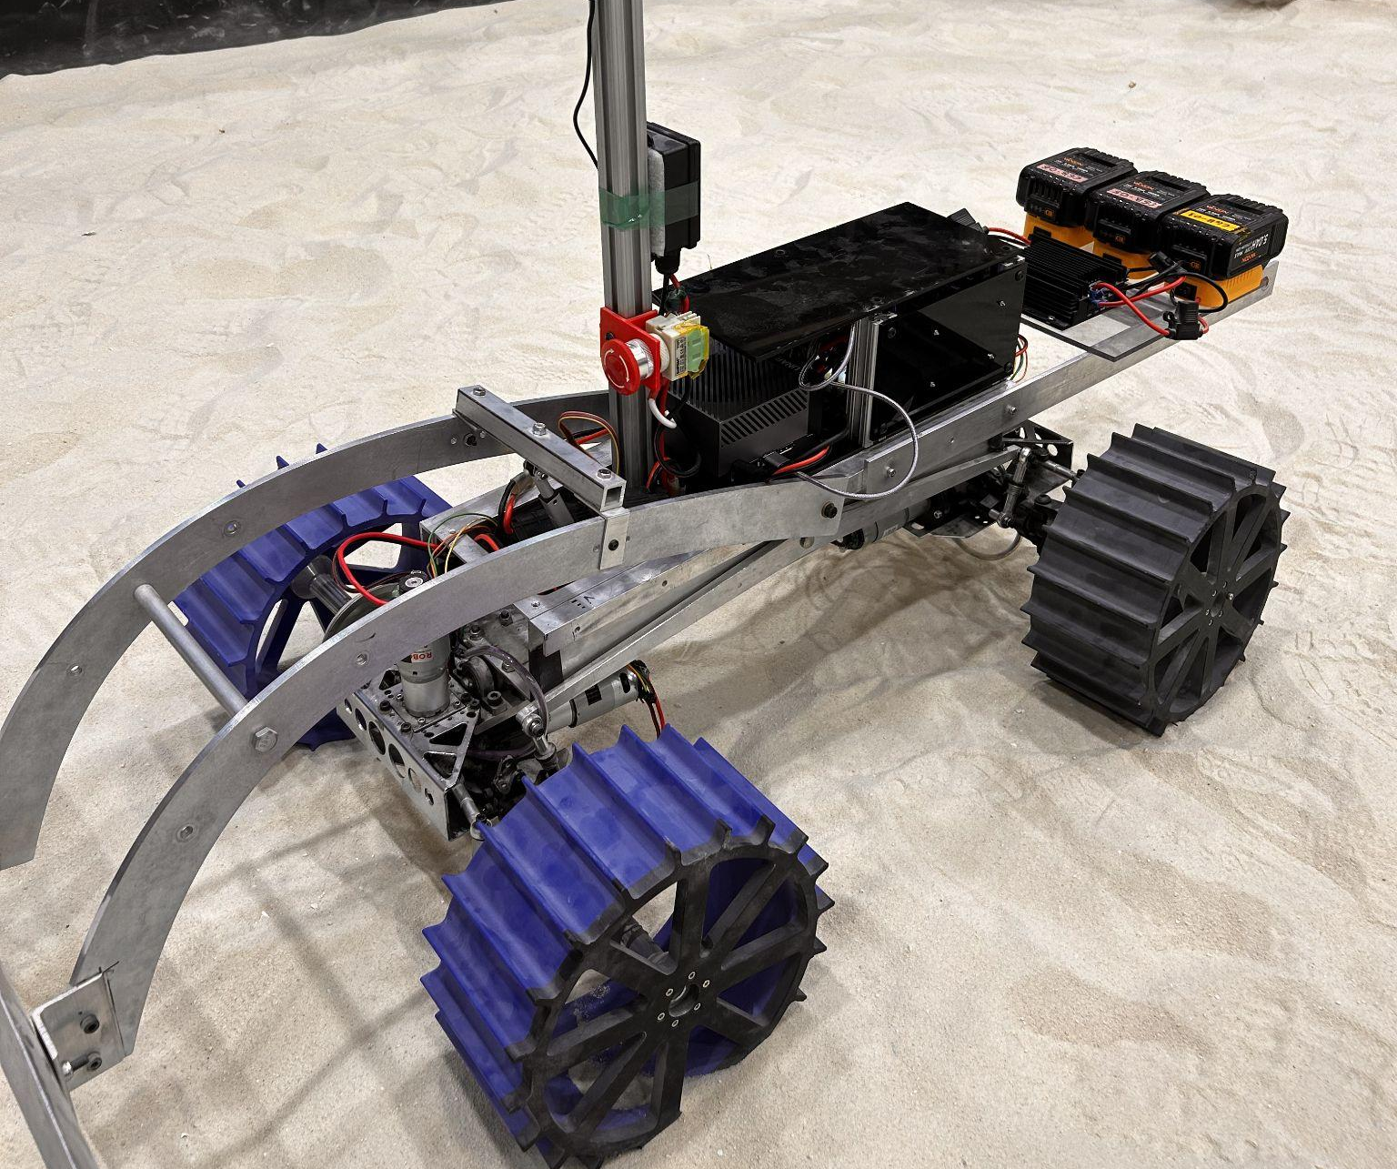
NASA/TP—2006–214605: Application to project
The fine particulate nature of the regolith necessitated the development of our dust resistant electronics box

Slide 30
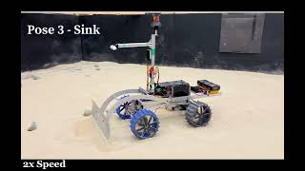
NASA/TP—2006–214605: Application to project
Our back-blading methodology for grading craters comes from the fact that lunar regolith has very low cohesion. It can be easily pushed to the sides if enough linear force is applied (such is the case when the entire weight of the rover is dragging the blade backwards)

Slide 31


Colonize the Moon!
Team Lunar ROADSTER
Any Questions? 🤖🦾🚀
“Starting with a foothold on the Moon, we pave the way to the cosmos”

Slide 32
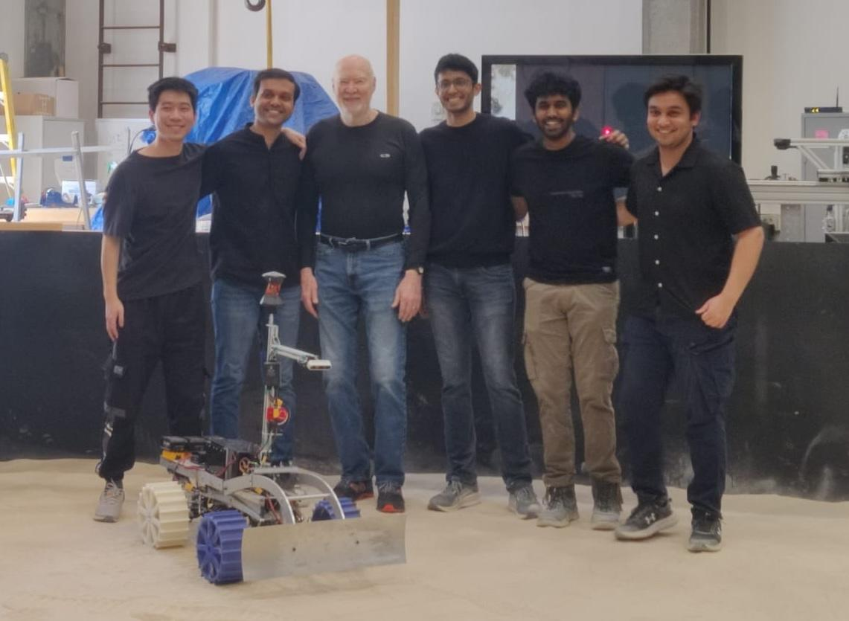
Thank You!
https://mrsdprojects.ri.cmu.edu/2025teami/

Slide 33
References
NASA-STD-8739.10
Electrical, Electronic, and Electromechanical (EEE) Parts Assurance Standard
https://standards.nasa.gov/sites/default/files/standards/NASA/Baseline/0/nasa-std-873910.pdf
NASA/TP—2006–214605
Lunar Regolith Simulant Materials: Recommendations for Standardization, Production, and Usage
https://ntrs.nasa.gov/api/citations/20060051776/downloads/20060051776.pdf

